Slide 1
Chapter 9
Neural Networks
Non-linear hypothesis
Neural Network is actually a pretty old idea, but had fallen out of favor for a while.
But today, it is the state of the art technique for many different machine learning problems.

Slide 2
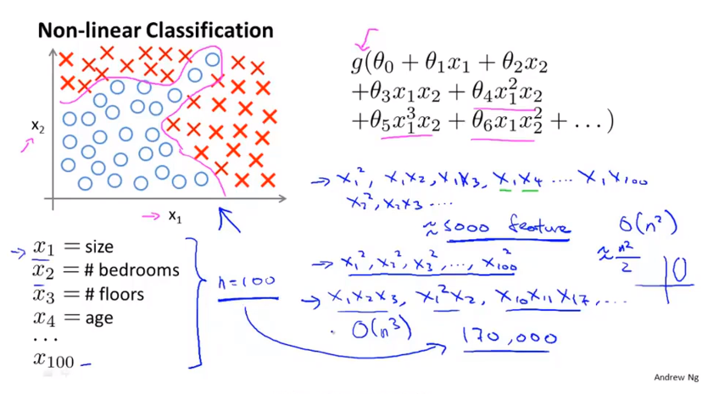
Chapter 9

Slide 3
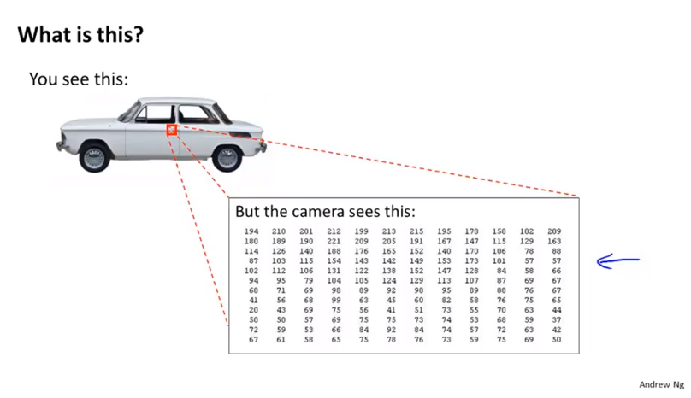
Chapter 9

Slide 4
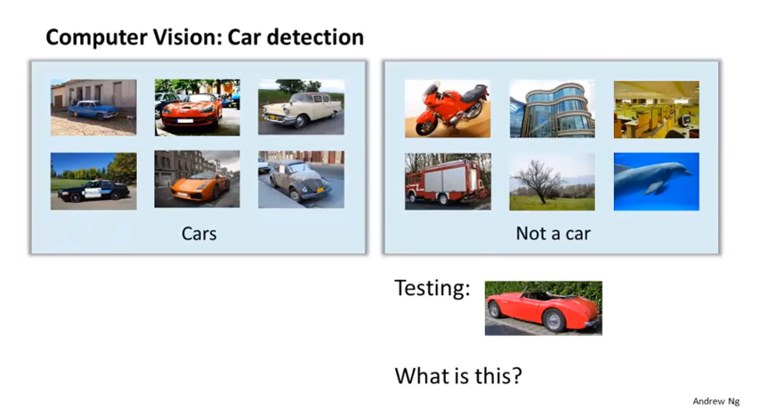
Chapter 9

Slide 5
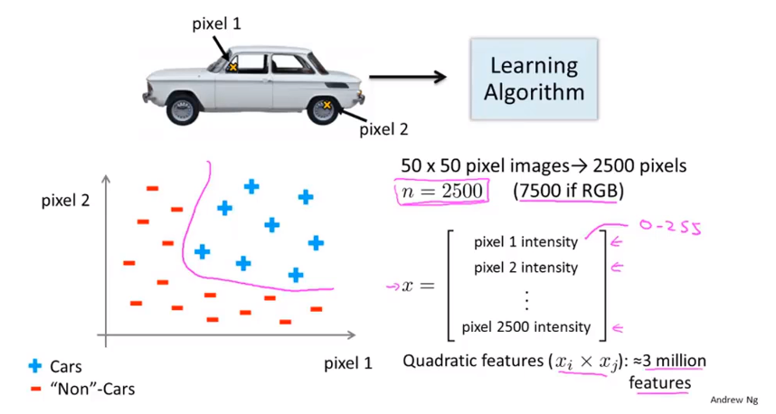
Chapter 9
Simple logistic regression together with adding in maybe the quadratic or the cubic features
That’s not a good way to learn complex nonlinear hypothesis when n is large because you end up with too many features.

Slide 6
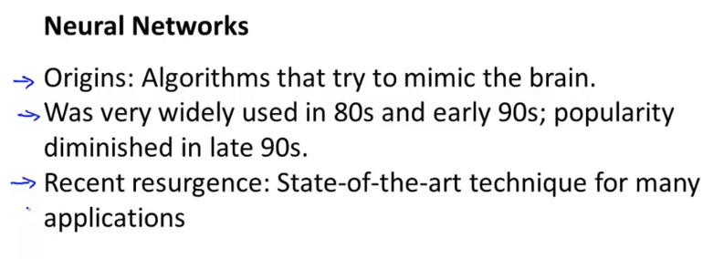
Chapter 9
Neural Networks
Neurons and the brain

Slide 7
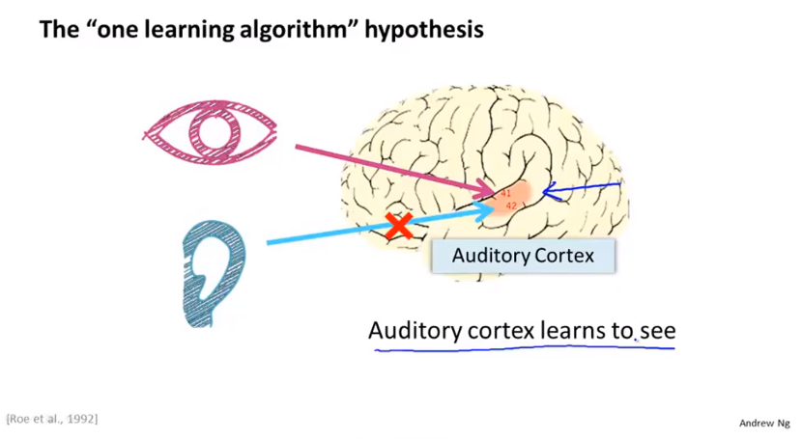
Chapter 9

Slide 8
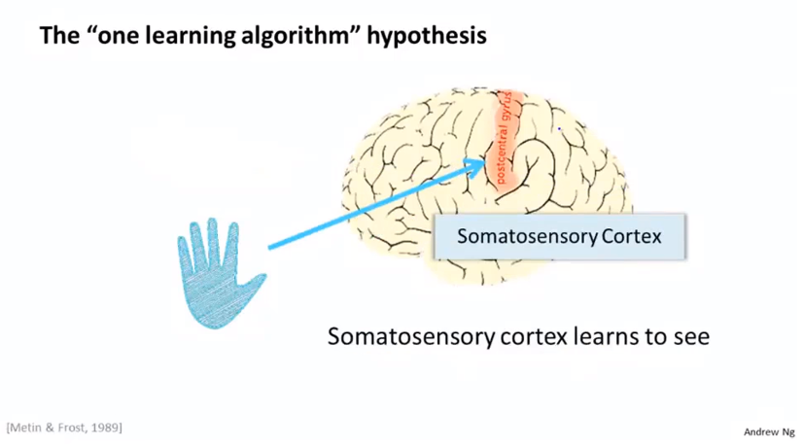
Chapter 9
Neuro-rewring experiments

Slide 9
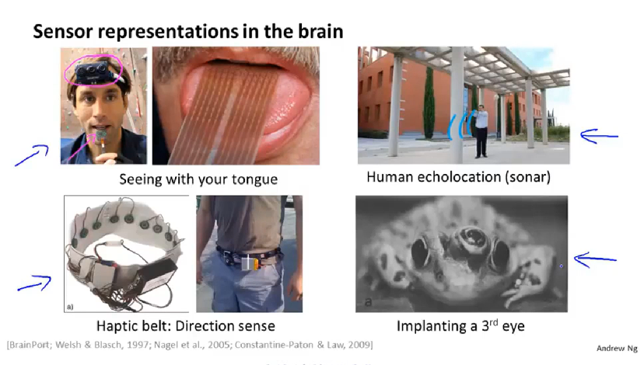
Chapter 9

Slide 10
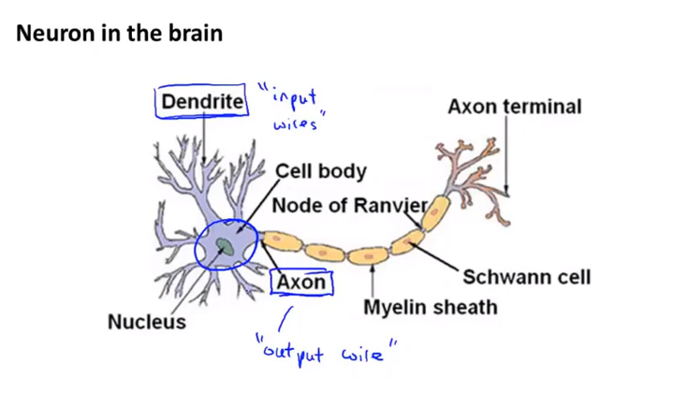
Chapter 9
Neural Networks
Model representation Ⅰ
Dendrite 树突
Axon 轴突
A computation unit

Slide 11
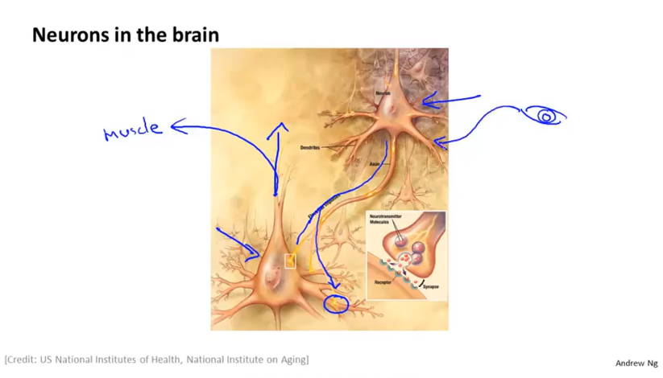
Chapter 9

Slide 12
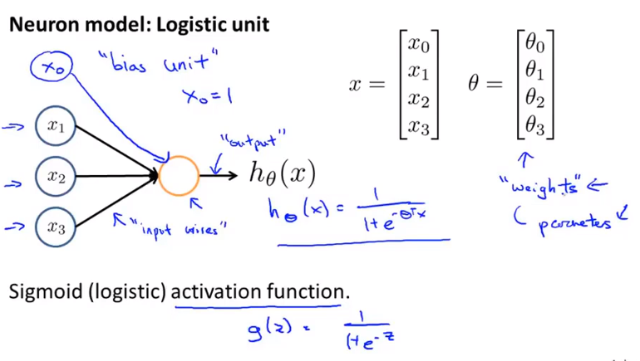
Chapter 9

Slide 13
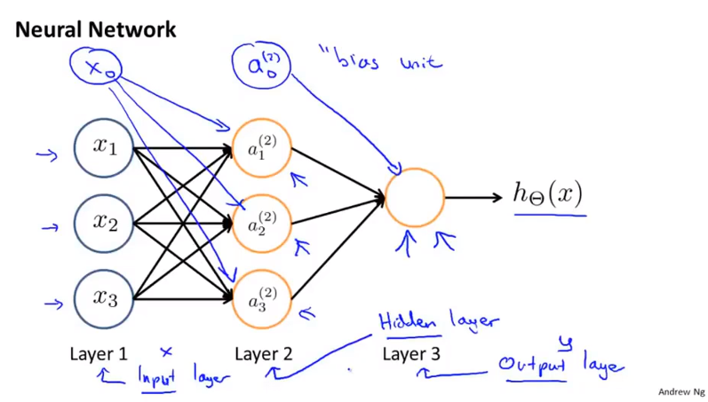
Chapter 9

Slide 14
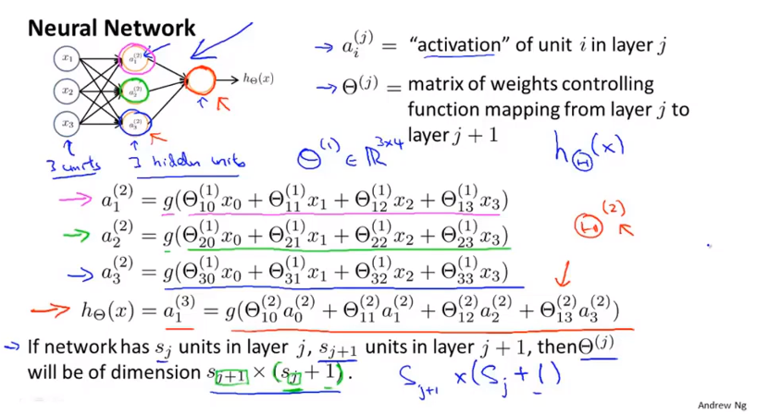
Chapter 9
by activation, it just means the value is computed by and that is output by a specific neural unit

Slide 15
Chapter 9
Neural Networks
Model representation Ⅱ

Slide 16
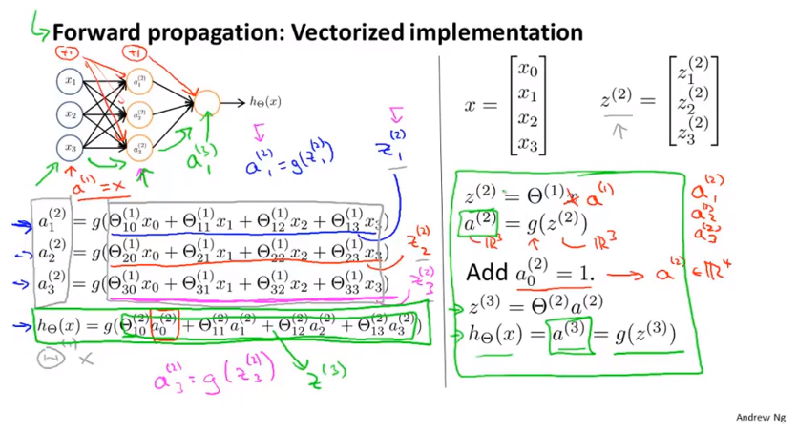
Chapter 9
Vectorized implementation gives us a relatively efficient way of computing h of x.

Slide 17
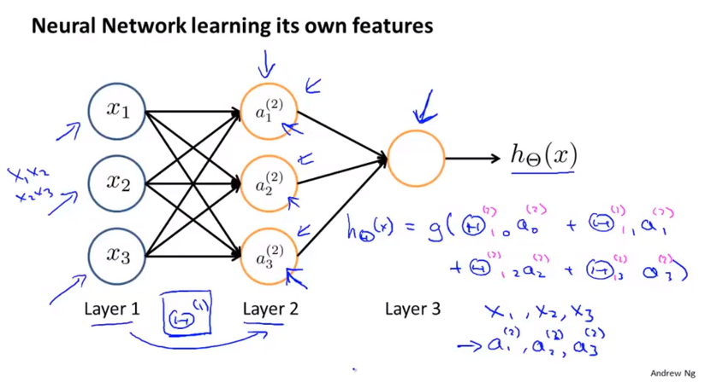
Chapter 9

Slide 18
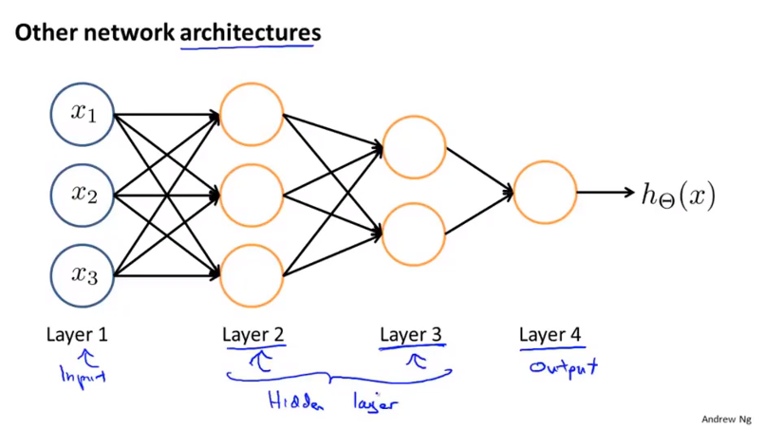
Chapter 9
How the feed forward propagation step in a neural network works
Start from the activations of the input layer, and forward propagate that to the first hidden layer, then the second hidden layer, and finally the output layer.

Slide 19
Chapter 9
Neural Networks
Examples and intuitions Ⅰ

Slide 20
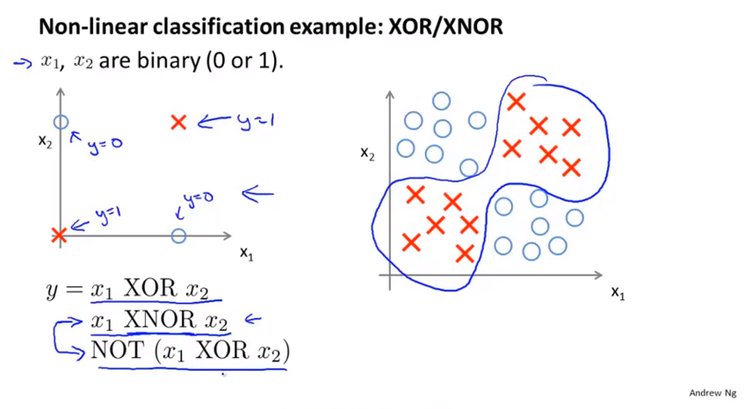
Chapter 9
XOR: 异或 不同为1 相同为0 equivalent: ¬x1∨x2 ∧ x1∨¬x2
NXOR: 同或 不同为0 相同为1 equivalent x1 ∧ ¬x2 ∨ ¬ x1 ∧ x2

Slide 21
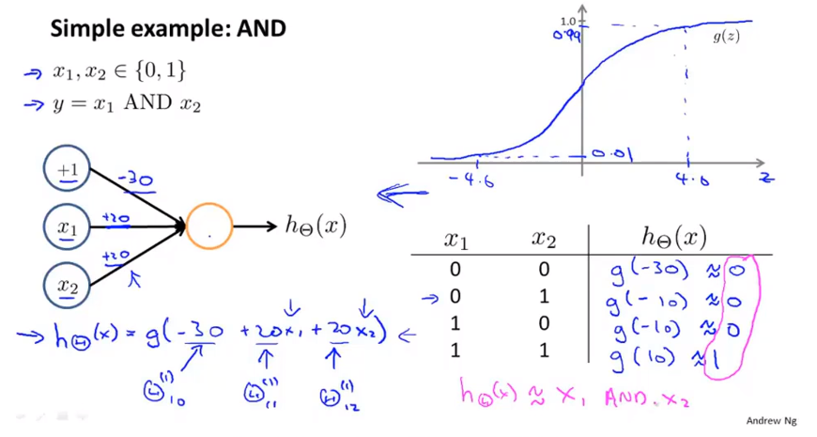
Chapter 9
+1 bias 偏置单元 / plus one unit

Slide 22
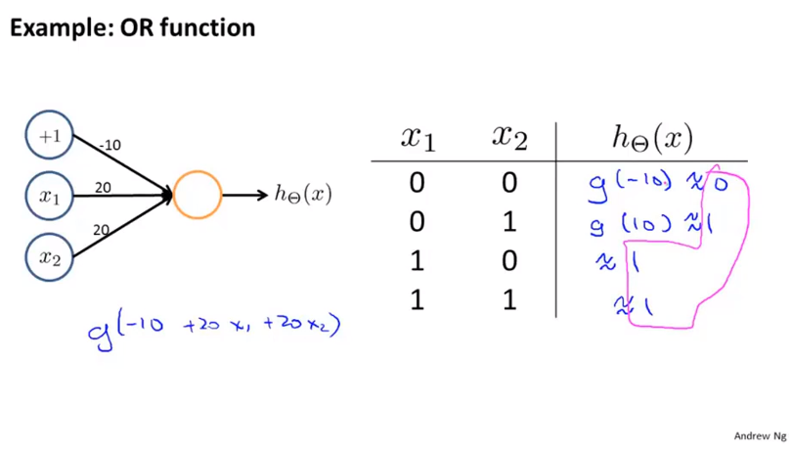
Chapter 9

Slide 23
Chapter 9
Neural Networks
Examples and intuitions Ⅱ

Slide 24
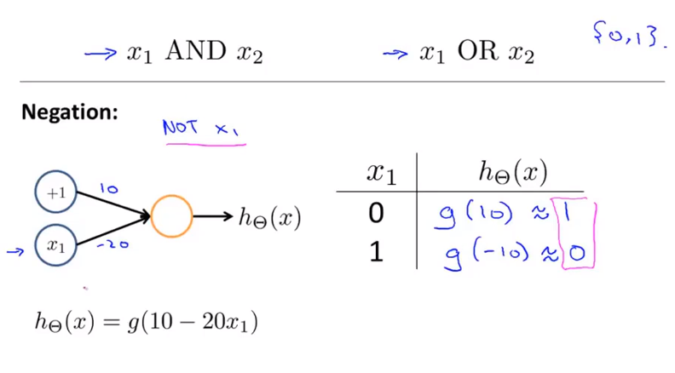
Chapter 9

Slide 25
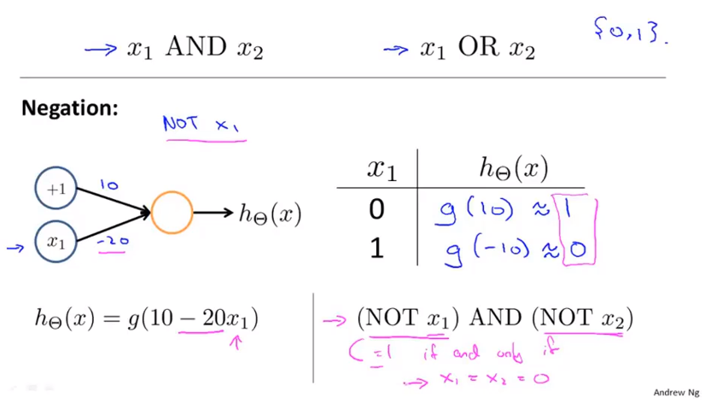
Chapter 9

Slide 26
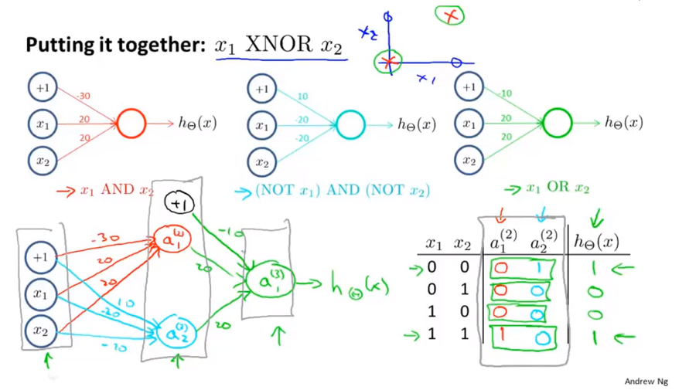
Chapter 9

Slide 27
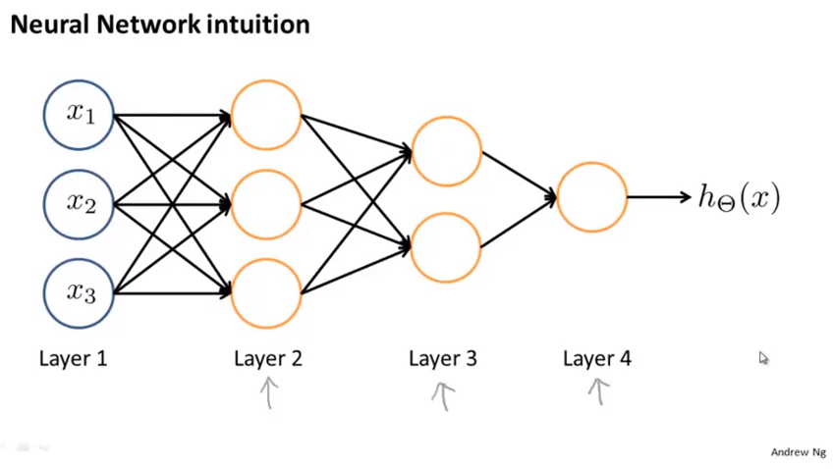
Chapter 9

Slide 28
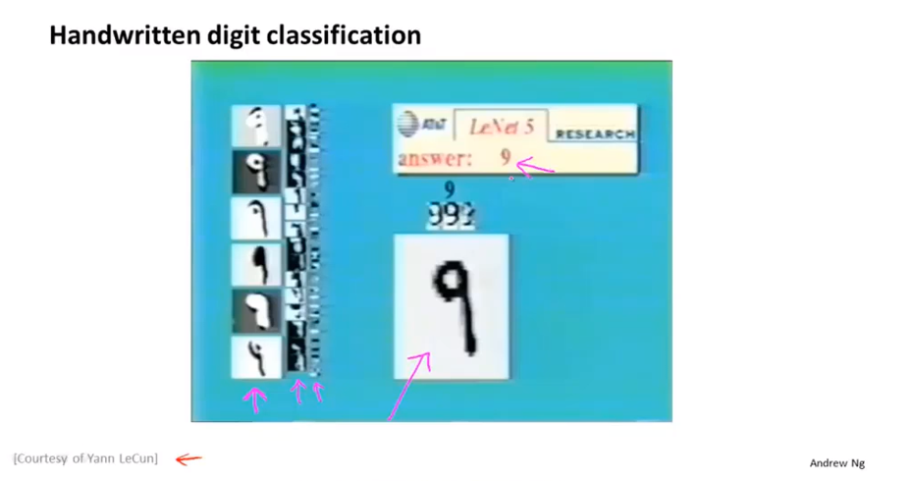
Chapter 9

Slide 29
Chapter 9
Neural Networks
Multi-class classification

Slide 30
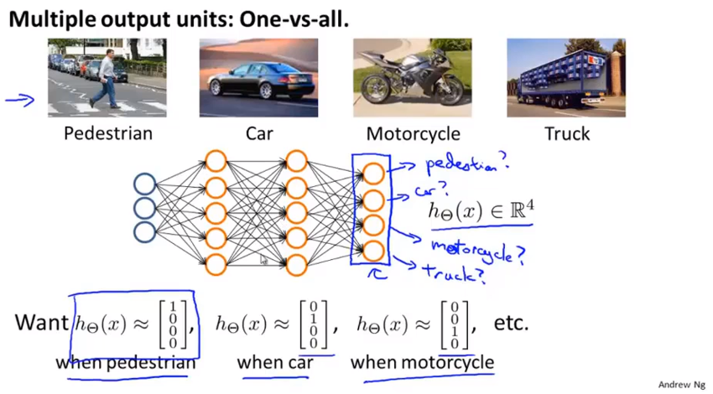
Chapter 9

Slide 31
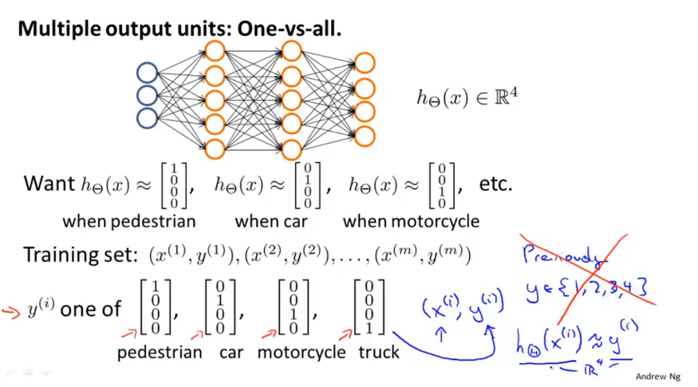
Chapter 9

